Slide 1
1 Corinthians 15:1-8 (NIV)
1 Now, brothers, I want to remind you of the gospel I preached to you, which you received and on which you have taken your stand. 2 By this gospel you are saved, if you hold firmly to the word I preached to you. Otherwise, you have believed in vain. 3 For what I received I passed on to you as of first importance : that Christ died for our sins according to the Scriptures, 4 that he was buried, that he was raised on the third day according to the Scriptures, 5 and that he appeared to Peter, and then to the Twelve.

Slide 2
1 Corinthians 15:1-8 (NIV)
6 After that, he appeared to more than five hundred of the brothers at the same time, most of whom are still living, though some have fallen asleep. 7 Then he appeared to James, then to all the apostles, 8 and last of all he appeared to me also, as to one abnormally born.

Slide 3


Slide 4
First.. A discussion
I want you to come up with the best but most basic Gospel message you can as a group.
Kids can you come to the front for a kids activity.

Slide 5
1 Corinthians 15:1-20
Now, brothers and sisters, I want to remind you of the gospel I preached to you, which you received and on which you have taken your stand. 2 By this gospel you are saved, if you hold firmly to the word I preached to you. Otherwise, you have believed in vain.
3 For what I received I passed on to you as of first importance[a]: that Christ died for our sins according to the Scriptures, 4 that he was buried, that he was raised on the third day according to the Scriptures, 5 and that he appeared to Cephas,[b] and then to the Twelve. 6 After that, he appeared to more than five hundred of the brothers and sisters at the same time, most of whom are still living, though some have fallen asleep. 7 Then he appeared to James, then to all the apostles, 8 and last of all he appeared to me also, as to one abnormally born.

Slide 6
1 Corinthians 15:1-20
9 For I am the least of the apostles and do not even deserve to be called an apostle, because I persecuted the church of God. 10 But by the grace of God I am what I am, and his grace to me was not without effect. No, I worked harder than all of them—yet not I, but the grace of God that was with me. 11 Whether, then, it is I or they, this is what we preach, and this is what you believed. 12 But if it is preached that Christ has been raised from the dead, how can some of you say that there is no resurrection of the dead? 13 If there is no resurrection of the dead, then not even Christ has been raised. 14 And if Christ has not been raised, our preaching is useless and so is your faith.

Slide 7
1 Corinthians 15:1-20
15 More than that, we are then found to be false witnesses about God, for we have testified about God that he raised Christ from the dead. But he did not raise him if in fact the dead are not raised. 16 For if the dead are not raised, then Christ has not been raised either. 17 And if Christ has not been raised, your faith is futile; you are still in your sins. 18 Then those also who have fallen asleep in Christ are lost. 19 If only for this life we have hope in Christ, we are of all people most to be pitied.
20 But Christ has indeed been raised from the dead, the first fruits of those who have fallen asleep.

Slide 8
THE GOSPEL MESSAGE
1. Christ died
2. Christ was buried
3. He was raised on the third day
4. Christ appeared to the apostles and disciples after his resurrection.

Slide 9
Not an afterthought
Psalms 16, 22 and 69
Isaiah 53
Zechariah 11, 12 and 13
The book of Jonah
AND MORE

Slide 10
Appearance
Peter
‘The Twelve’
To the 500
Paul himself

Slide 11
Another discussion
How do you know that the resurrection happened?

Slide 12
4 questions to answer
• Were these authors really present to see what they said they saw?
• Could their claims be corroborated in some way?
• Were they consistent, or did their story about Jesus change over time?
• Were they motivated to lie?

Slide 13
They were around at the right time
The book of acts doesn’t mention key events such as:
  Destruction of the temple (70 A.D)
  The siege of Jerusalme (late 60s A.D)
  Death of Peter and Paul ( 65 A.D)
  Death of James – Jesus’ brother (62 A.D)
The book of acts would’ve been written before 62 A.D
It is likely the Gospel of Luke was written within 15 years of the resurrection.

Slide 14
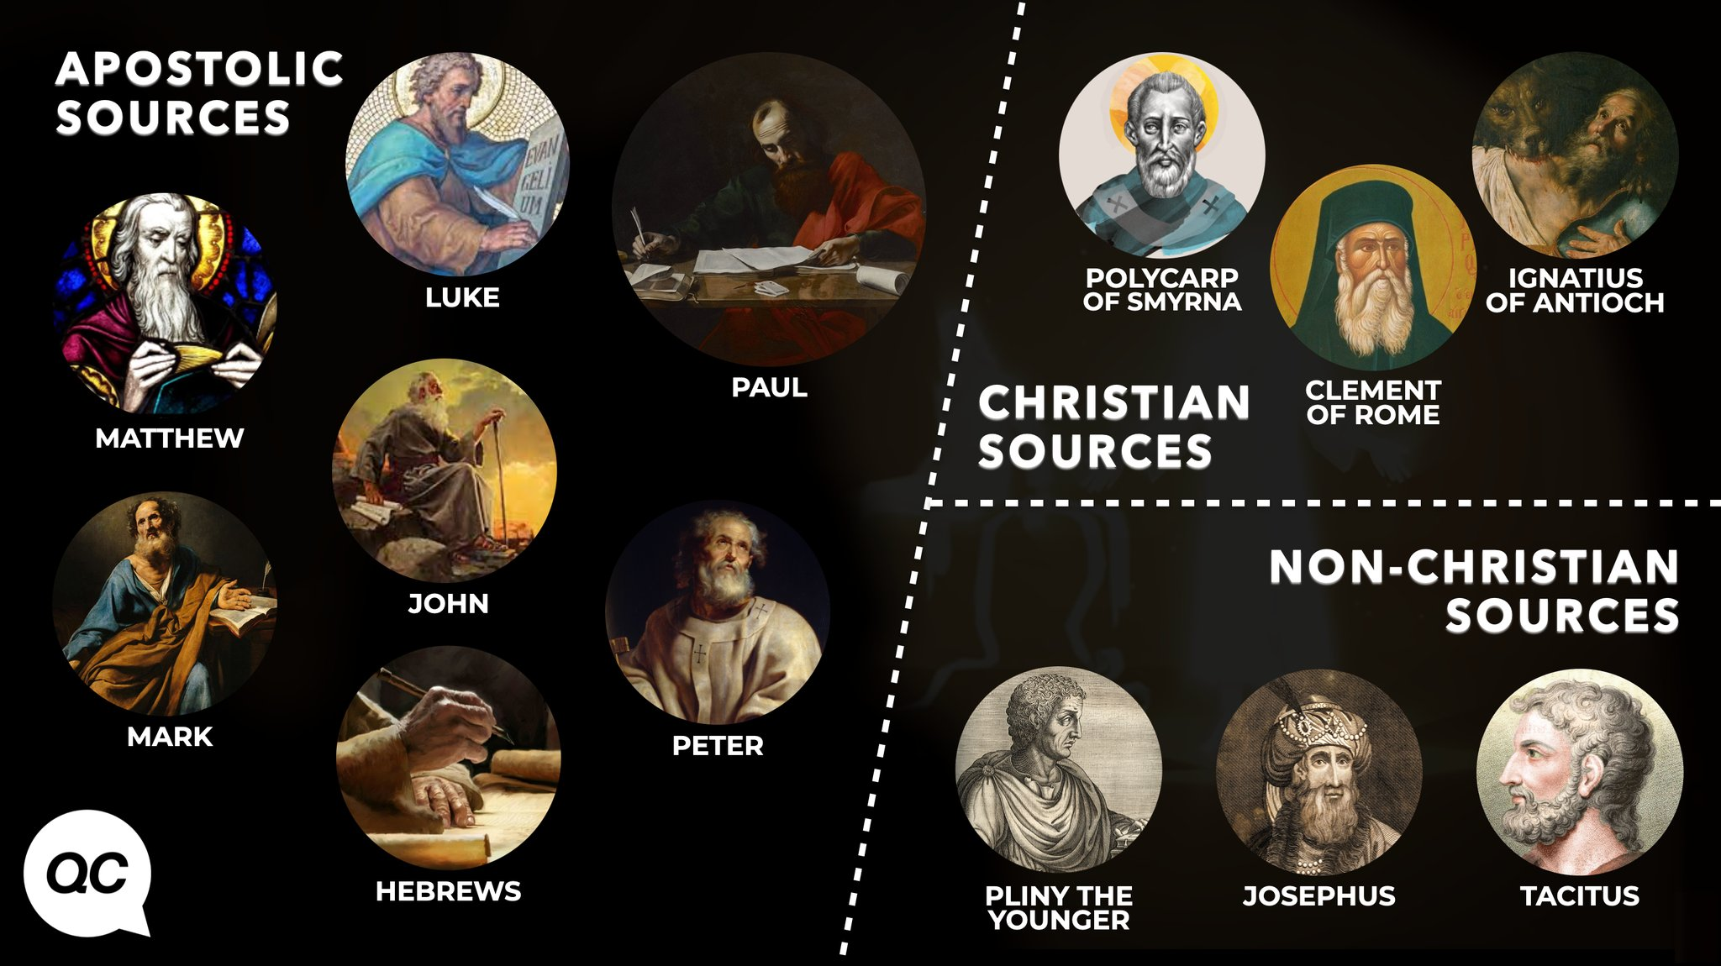
Can it be corroborated?

Slide 15
Motives
Money:
  They often gave away all their money to help those around them and each other live a basic lifestyle
Power:
  Persecuted for 300 years.

Slide 16
Discuss some more
How does the resurrection change our future?
Kids can you come forward again to play a game

Slide 17
If the resurrection didn’t happen
Our preaching is useless (the apostles and our own today)
Our faith is useless and futile
We are false witnesses (Both the apostles and our own because we repeat their message)
We are still in our sin
Those who have fallen asleep in Christ will never wake up.

Slide 18
But CHRIST
The opposite is true
  Our preaching is valid and useful
  Our faith is valid
  Our witness is not false
  We are not in our sins
  We can be comforted that our brothers and sisters will wake once more.

Slide 19
Last discussion
So how does the resurrection change our today
Kids once last time at the front please

Slide 20
The resurrection is the ultimate change
It changes our purpose
It changes our heart attitudes
It changes the foundations of our relationships
It changes even the mundane moments
It changes everything

Slide 21
Challenge
Truly Consider the Resurrection and what it means for you.
Do something to change your today.

